Slide 1
Immunisation in Africa Transforming health outcomes across the continent
Updated May 2014

Slide 2
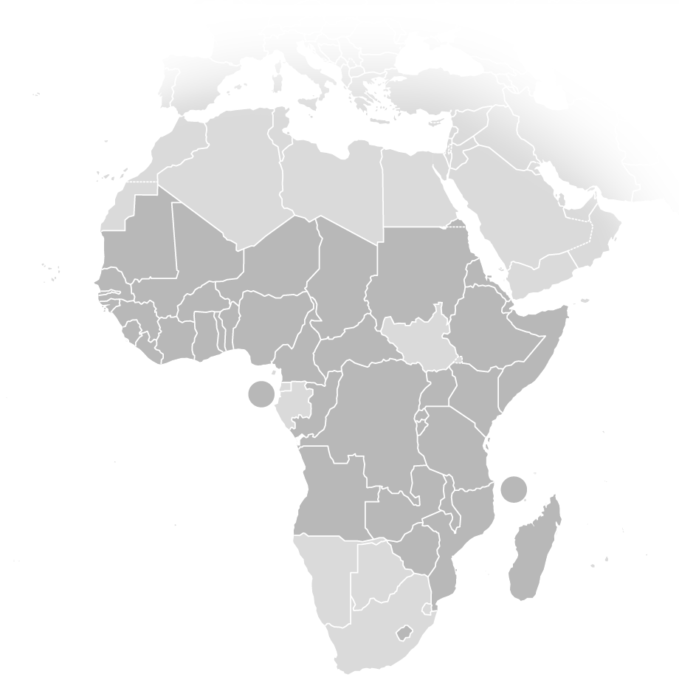
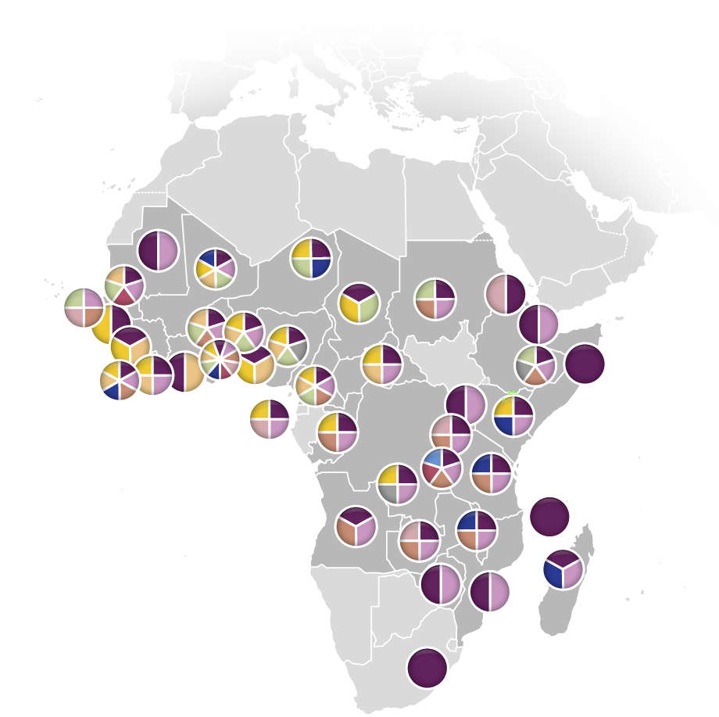
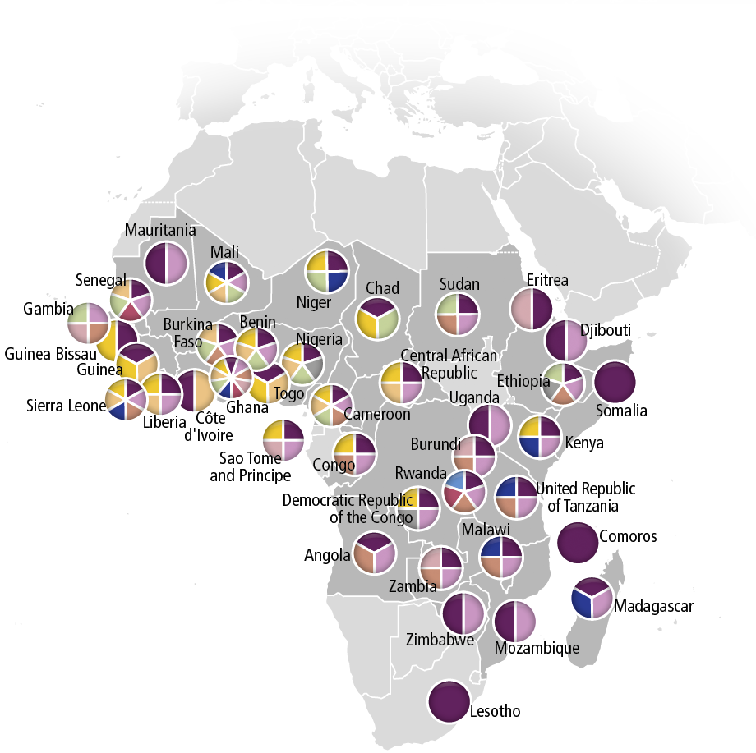
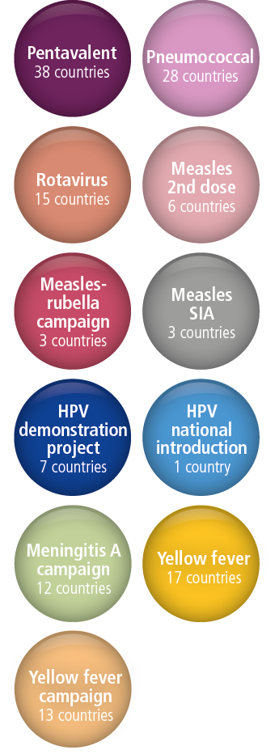
More than 140 GAVI-supported introductions and campaigns in Africa since 2001
SIA= supplementary immunisation activities
Note: The Gambia introduced pentavalent vaccine in 1997 but is currently receiving GAVI support for its programme.
Source: GAVI Alliance data as of 30 April 2014

Slide 3
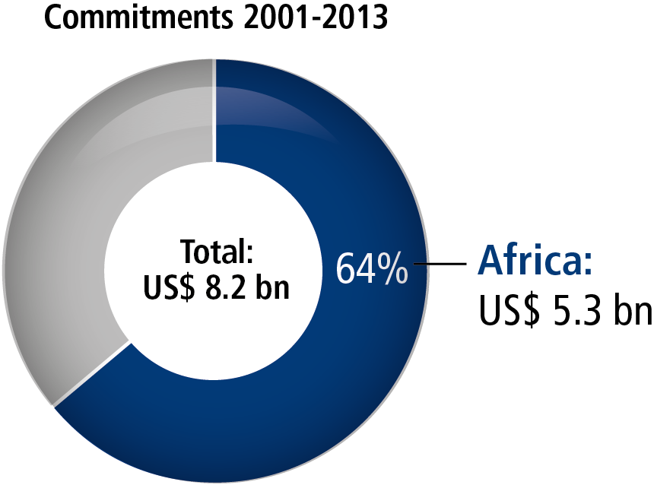
Over US$ 5 billion committed to GAVI-supported programmes in Africa
GAVI global commitments and disbursements, 2001–2013
Commitments
Disbursements
Source: GAVI Alliance data as of 31 December 2013
Notes:
Includes the WHO Africa region + Djibouti, Somalia, South Sudan and Sudan.

Slide 4
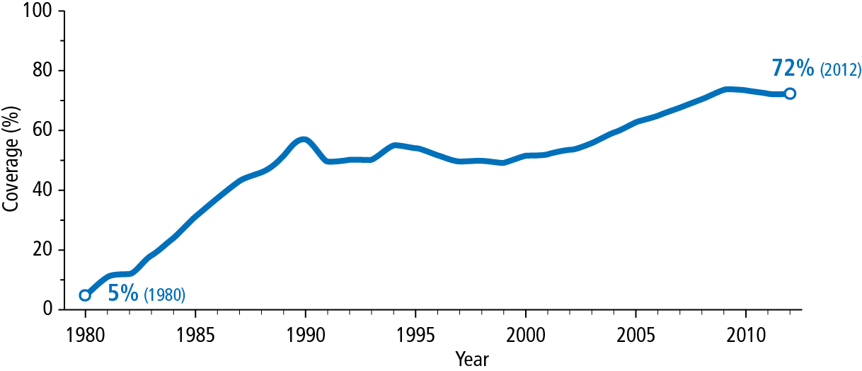
DTP3 coverage in the WHO Africa region increased from 5% to 72%, 1980–2012
Launch of GAVI
Note: WHO Africa region only
Source: WHO-UNICEF estimates of national immunisation coverage, 2013
Notes:
GAVI-supported African countries not included in the WHO Africa region are: Djibouti, Somalia, South Sudan and Sudan.

Slide 5
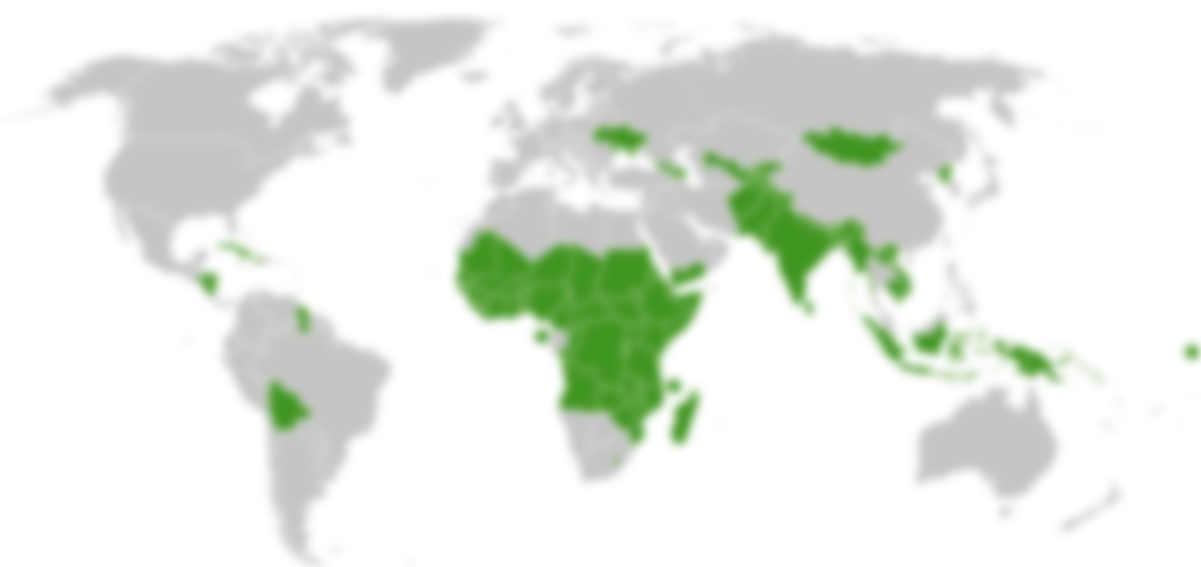
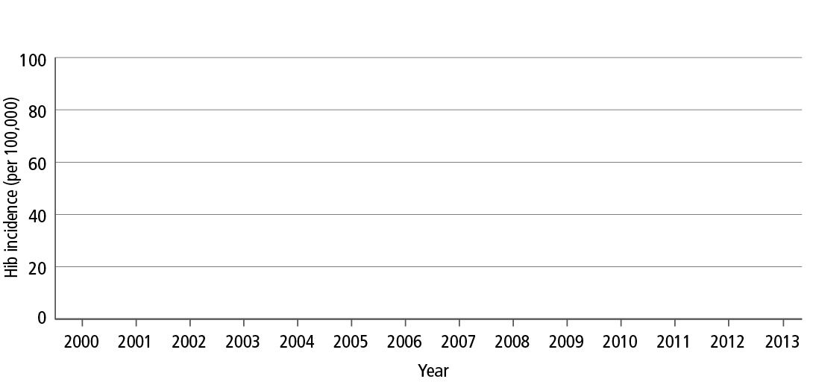
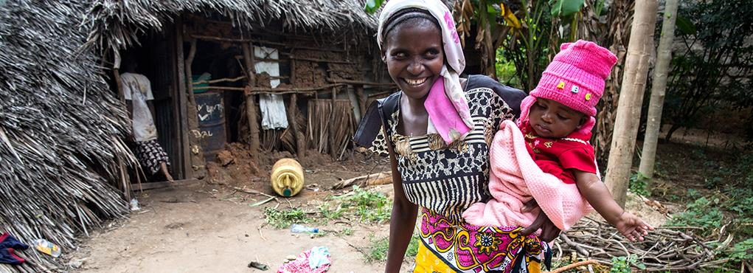
Impact on the ground
Eliminating Hib meningitis in Kenya (Kilifi district)
Source: Anthony Scott, Wellcome Trust Senior Research Fellow in Clinical Science KEMRI-Wellcome Trust Research Programme , Kilifi, Kenya, January 2014
Notes:
Where quality data exists, vaccine impact is confirmed.

Slide 6
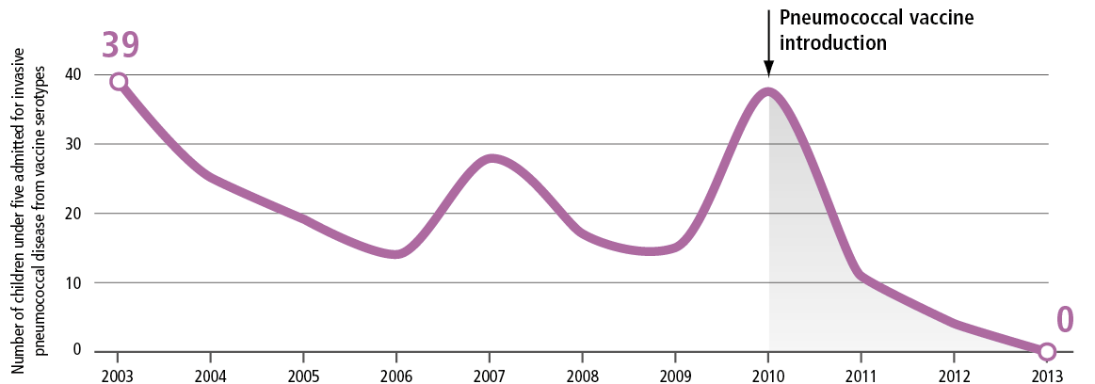
Impact on the ground
Admissions of children under five for invasive pneumococcal disease from vaccine serotypes, Kilifi District Hospital, 2003–2013
Year
Source: Anthony Scott, KEMRI-Wellcome Trust Research Programme, Kilifi, Kenya, January 2014
Notes:
Where quality data exists, vaccine impact is confirmed.
The line shows the annual number of admissions for Invasive Pneumococcal Disease of serotypes 1, 4, 5, 6B, 7F, 9V, 14, 18C, 19F, 23F among children aged <5 years admitted to Kilifi District Hospital (KDH) who were residents of the Kilifi Health and Demographic Surveillance System.
Routine immunisation of children <12 months began on January 11, 2011 and the first round of catch-up vaccination took place between Jan 31-Feb 6, 2011. Since the introduction of the catch-up campaign there has been a marked attenuation in the frequency of cases. However, there has been considerable variation in the number of cases year-on-year and it will take several years to be confident that changes in disease frequency are attributable to vaccine.

Slide 7
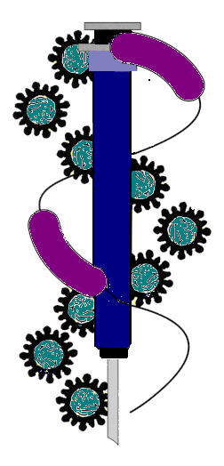
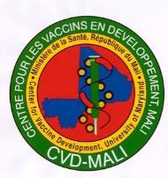
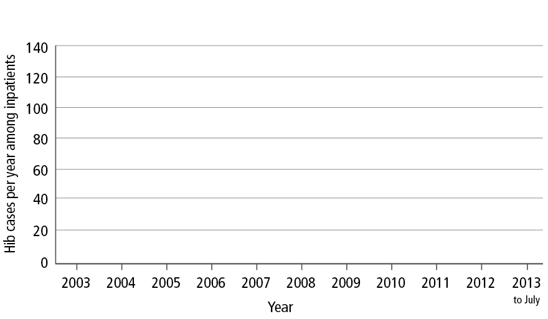
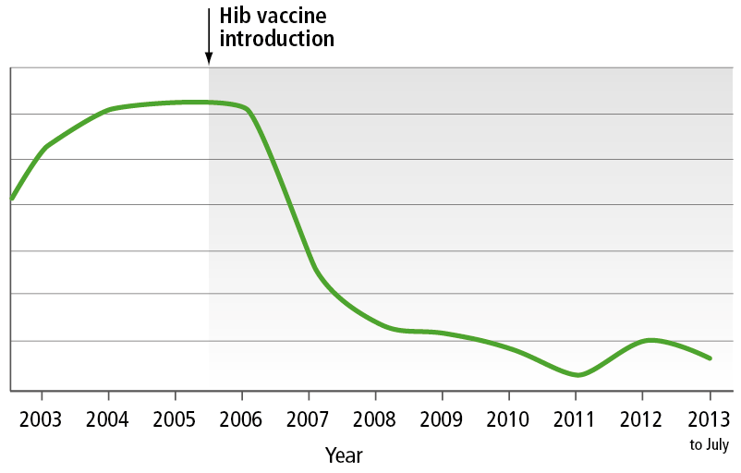
Impact on the ground
Reducing Hib meningitis in Bamako, Mali
Source: Courtesy: Centre pour le Développement des Vaccins – Mali, 2013
Notes:
Where quality data exists, vaccine impact is confirmed.

Slide 8
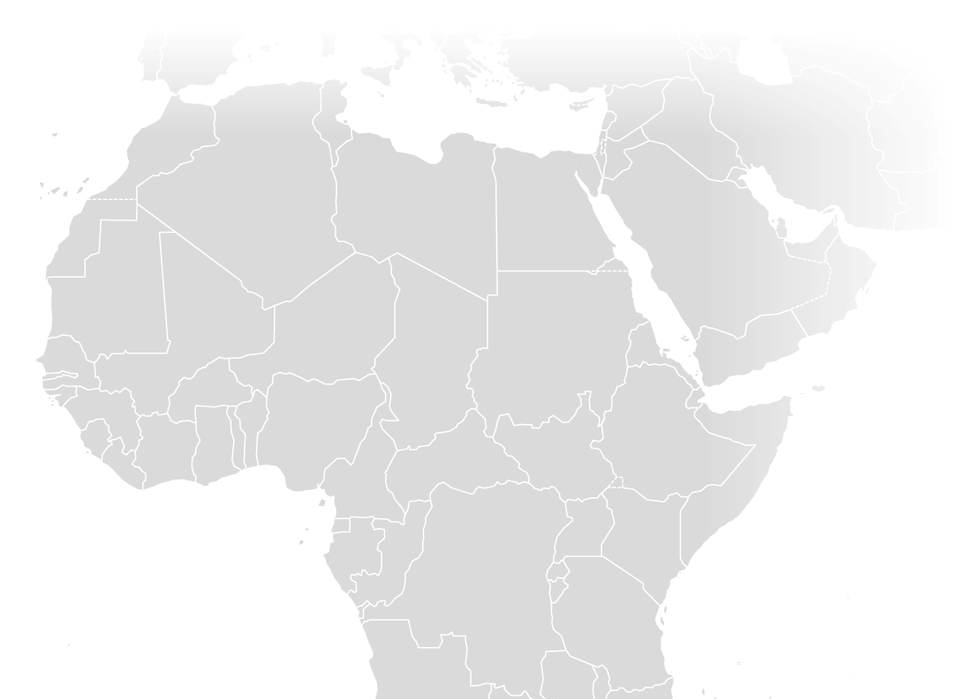
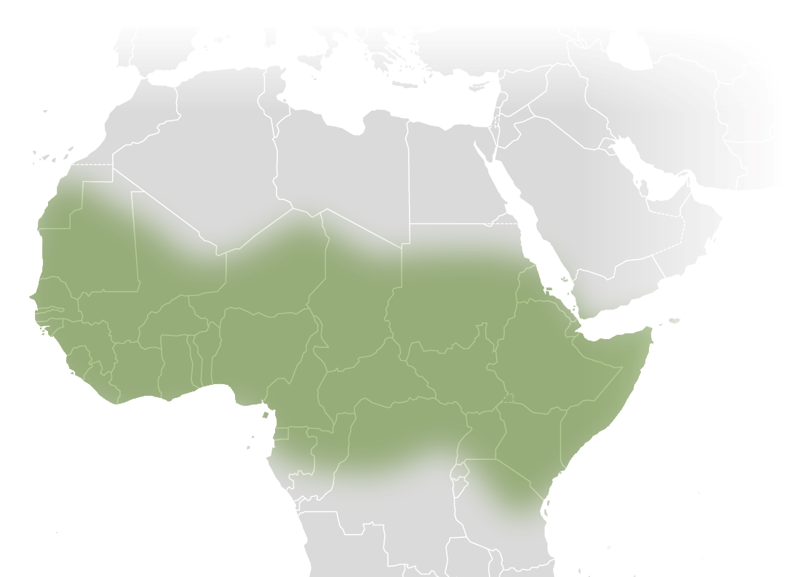
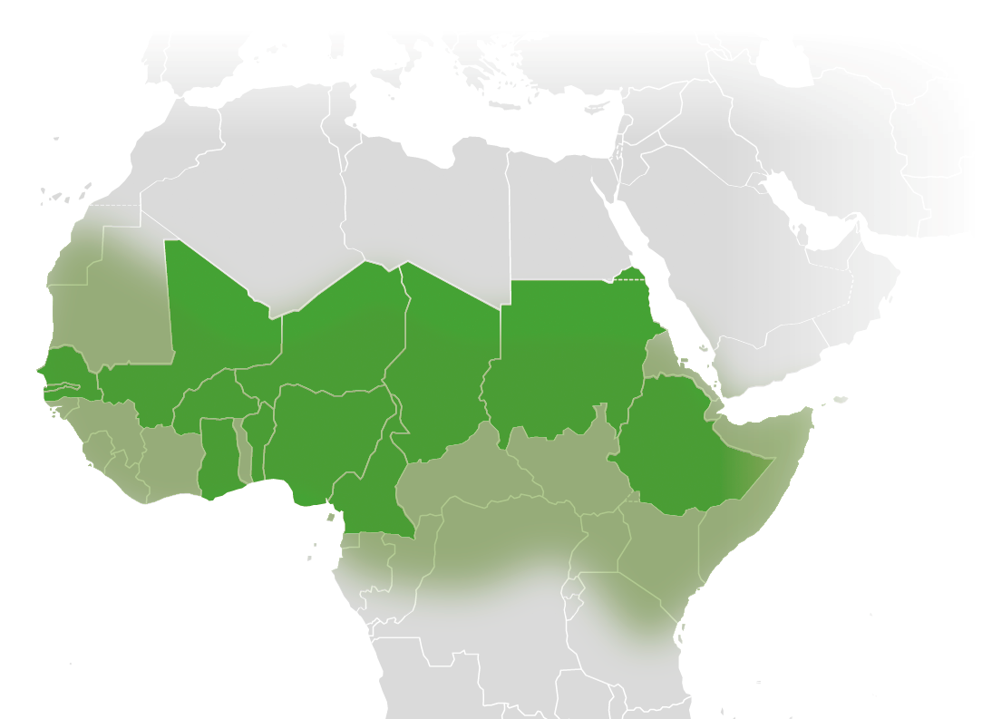
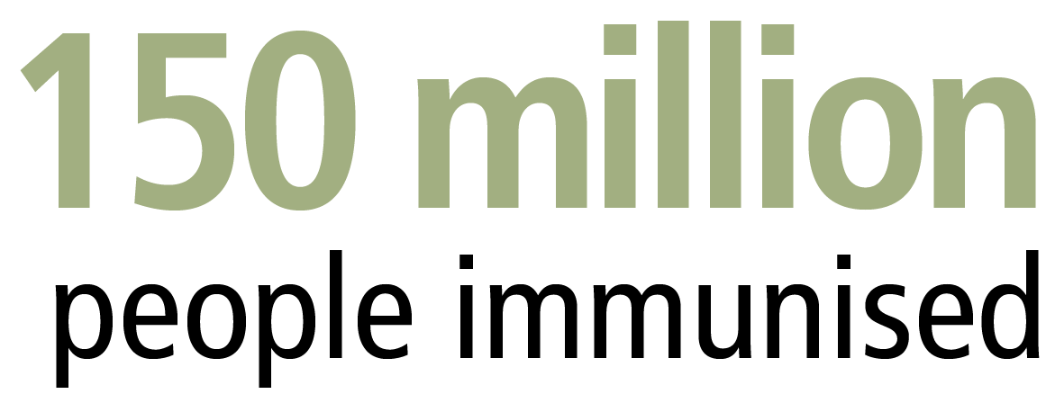
Impact in the meningitis belt
Impact:
Number of men A cases:
2008
842
156
16
2012
0
0
0
Niger
Burkina Faso Mali
Sources: People immunised: Preliminary WHO data as of January 2014. Impact: Meningitis A Conjugate Vaccine Immunization Campaign. Joint WHO/UNICEF Progress Report: January to December 2012.
Notes:
Countries in dark green have launched men A campaigns with GAVI support:
Benin
Burkina Faso
Cameroon
Chad
Ethiopia
Gambia
Ghana
Mali
Niger
Nigeria
Senegal
Sudan

Slide 9
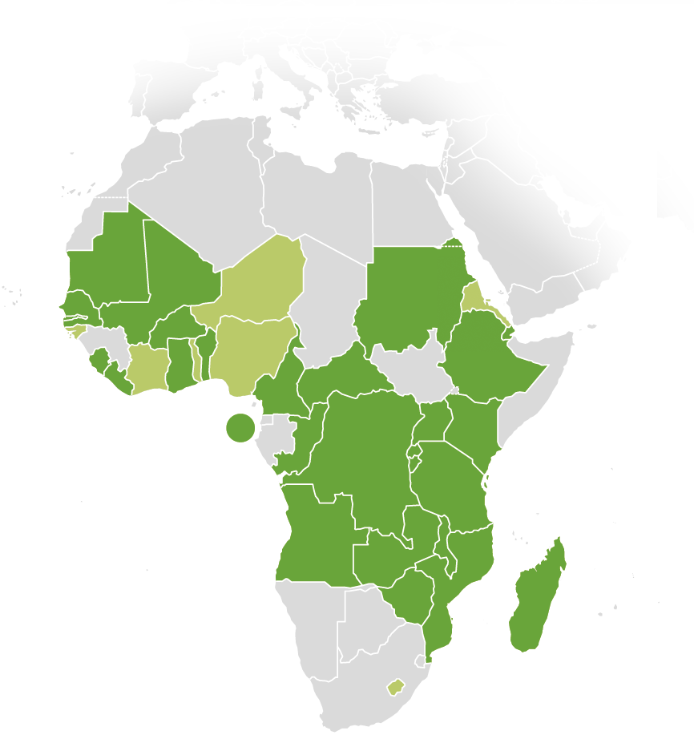
28 countries in Africa have introduced pneumococcal vaccine with GAVI support since 2009
Source: GAVI Alliance data as of 30 April 2014
Notes:
Approved for pneumococcal vaccine (year introduced)
Angola (2013)
Benin (2011)
Burkina Faso (2013)
Burundi (2011)
Cameroon (2011)
Central African Republic (2011)
Congo (2012)
Côte d’Ivoire
Democratic Republic of the Congo (2011)
Djibouti (2012)
Eritrea
Ethiopia (2011)
Ghana (2012)
Gambia (2009)
Guinea-Bissau
Kenya (2011)
Lesotho
Liberia (2014)
Madagascar (2012)
Malawi (2011)
Mali (2011)
Mauritania (2013)
Mozambique (2013)
Niger
Nigeria
Rwanda (2009)
Sao Tome and Principe (2012)
Senegal (2013)
Sierra Leone (2011)
Sudan (2013)
Tanzania (2012)
Togo
Uganda (2013)
Zambia (2013)
Zimbabwe (2012)

Slide 10
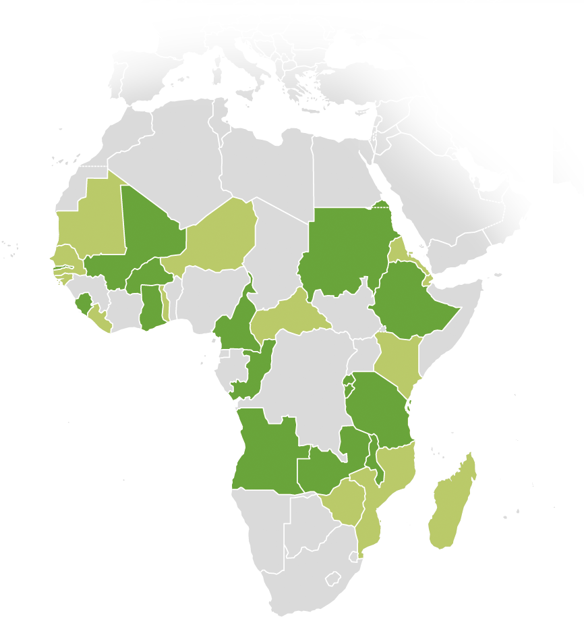
15 countries in Africa have introduced rotavirus vaccine with GAVI support since 2011
Source: GAVI Alliance data as of 30 April 2014
Notes:
Approved for rotavirus vaccine (year introduced)
Angola (2014)
Burkina Faso (2013)
Burundi (2013)
Cameroon (2014)
Central African Republic
Congo (2014)
Djibouti
Eritrea
Ethiopia (2013)
Gambia (2013)
Ghana (2012)
Guinea-Bissau
Kenya
Madagascar
Malawi (2012)
Mali (2014)
Niger
Rwanda (2012)
Sierra Leone (2014)
Sudan (2011)
Tanzania (2012)
Togo
Zambia (2013)
Zimbabwe
Liberia
Mauritania
Senegal
Mozambique

Slide 11
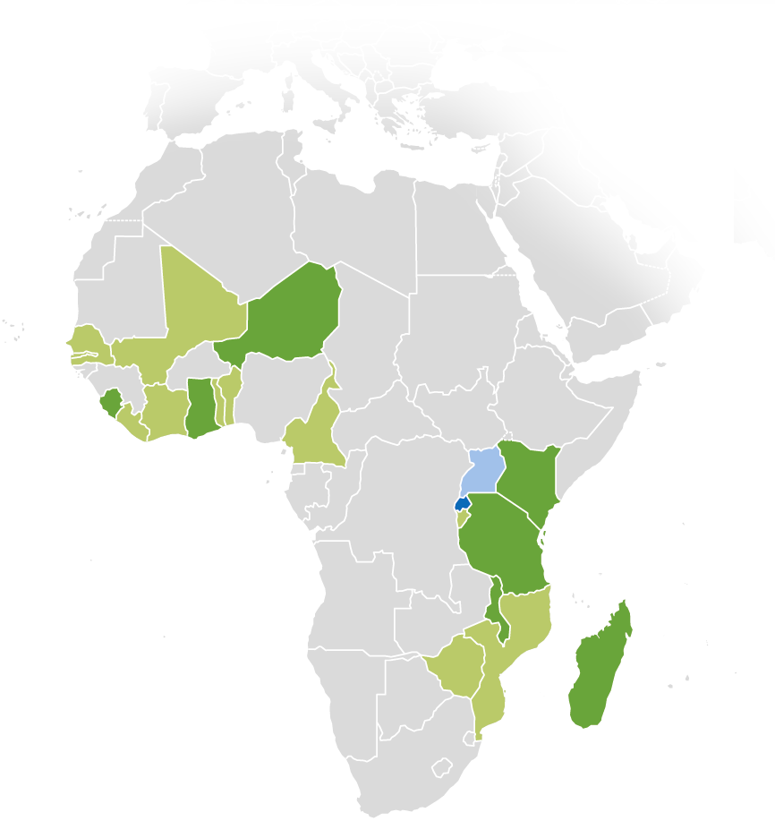
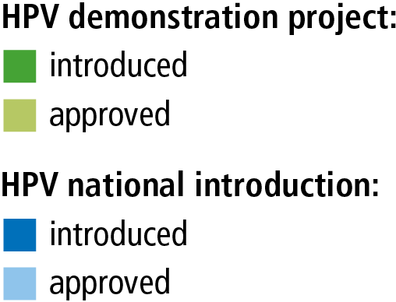
20 African countries approved for HPV vaccine support – 8 have launched programmes since 2013
Source: GAVI Alliance data as of 30 April 2014
Notes:
7 African countries have launched HPV demonstration projects:
Ghana, Kenya, Madagascar, Malawi, Niger, Sierra Leone, Tanzania
1 country has introduced HPV vaccine nationally with GAVI support: Rwanda
Approved for HPV demonstration projects:
Benin
Burundi
Cameroon
Côte d’Ivoire
Gambia
Ghana
Kenya
Liberia
Madagascar
Malawi
Mali
Mozambique
Niger
Senegal
Sierra Leone
Tanzania
Togo
Zimbabwe
Approved for HPV national introduction:
Rwanda
Uganda

Slide 12
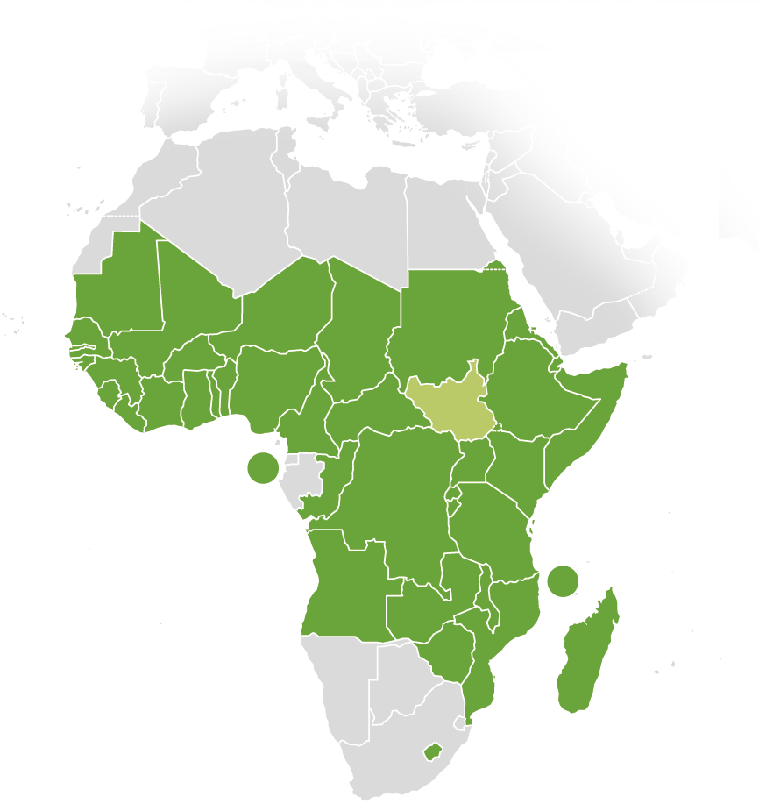
38 African countries have introduced pentavalent vaccine with GAVI support since 2001
* The Gambia introduced pentavalent vaccine in 1997 but is currently receiving GAVI support for its programme.
Source: GAVI Alliance data as of 30 April 2014
Notes:
Introduced pentavalent vaccine with GAVI support:
Angola
Benin
Burkina Faso
Burundi
Cameroon
Central African Republic
Chad
Comoros
Congo
Democratic Republic of the Congo
Côte d'Ivoire
Djibouti
Eritrea
Ethiopia
Ghana
Guinea
Guinea Bissau
Kenya
Lesotho
Liberia
Madagascar
Malawi
Mali
Mauritania
Mozambique
Niger
Nigeria
Rwanda
Sao Tome and Principe
Senegal
Sierra Leone
Somalia
Sudan
Republic of Tanzania
Togo
Uganda
Zambia
Zimbabwe
NB: The Gambia introduced pentavalent vaccine prior to GAVI (in 1997), but is currently receiving GAVI support for its pentavalent programme.
Approved:
South Sudan

Slide 13
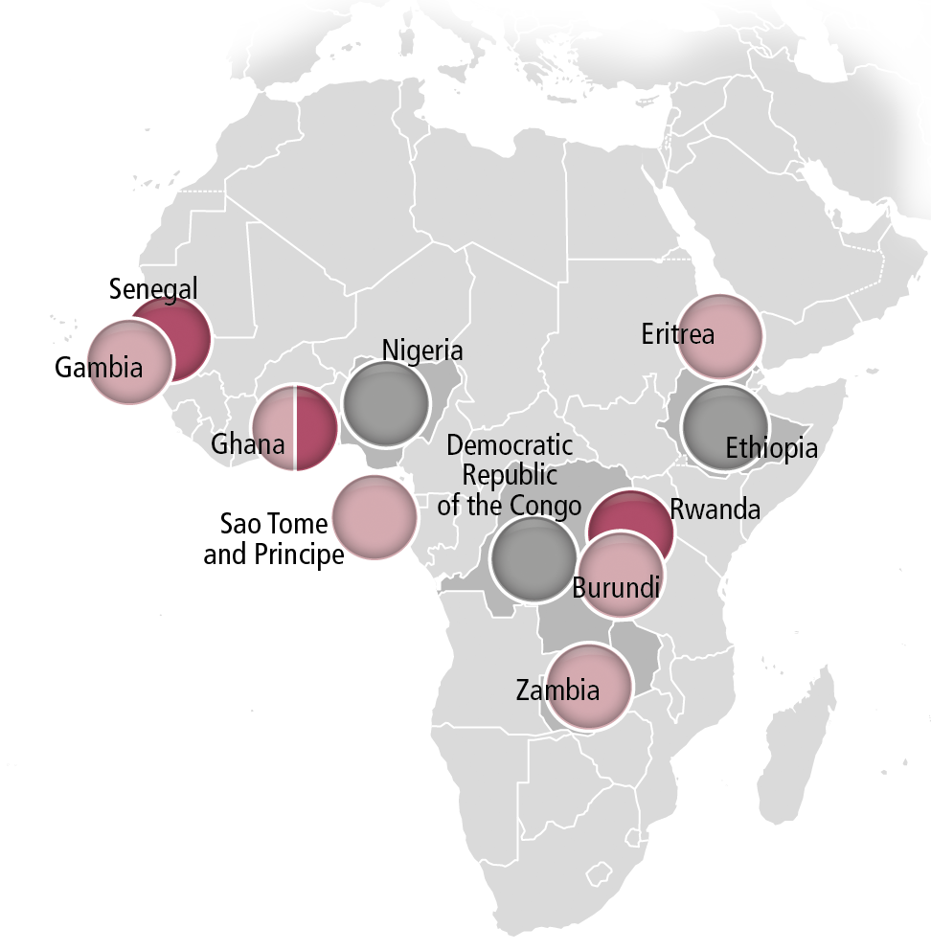
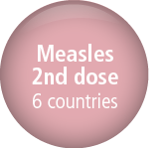
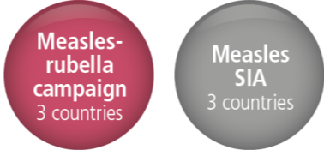
GAVI-supported measles and measles-rubella programmes in 11 countries in Africa since 2012
SIA= supplementary immunisation activities
Source: GAVI Alliance data as of 30 April 2014
Notes:
Measles second dose programmes were first launched in African countries with GAVI support in 2012, and measles supplementary immunisation activities (SIA) and measles-rubella campaigns in 2013.

Slide 14
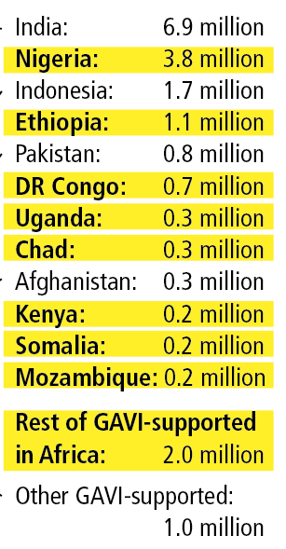
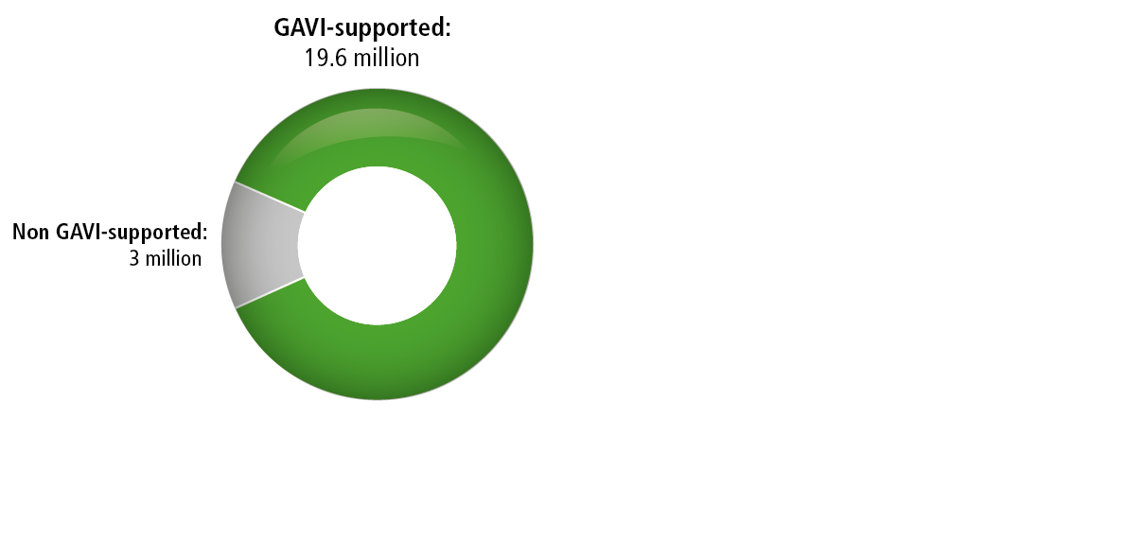
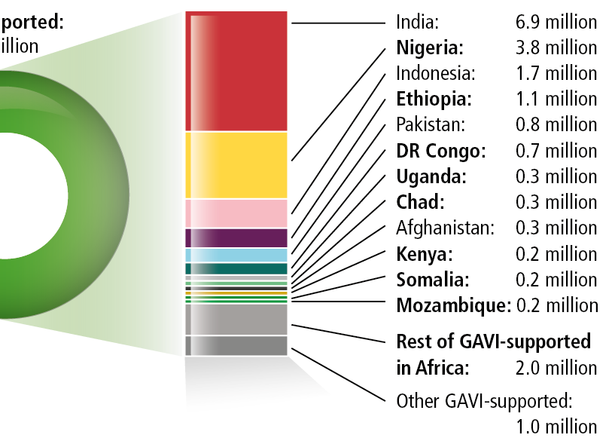
22.6 million children unimmunised with DTP3 ‒ 9 million in GAVI-supported countries in Africa
Source: WHO/UNICEF coverage estimates 2012 revision. July 2013

Slide 15
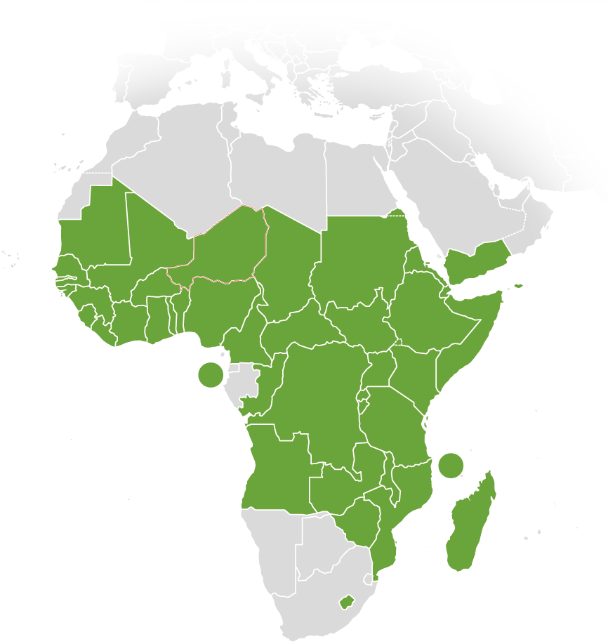
African countries increase their co-financing of new vaccines
Source: GAVI Alliance data as of April 2014

Slide 16
